Slide 1
Introducing preLAS 2000
preLAS
Gina Davis
Assessment Consultant
gdavis@datarecognitioncorp.com
210.861.7445

Slide 2
Agenda
preLAS
Language Assessment Needs for Early Learners
Introduction to preLAS
Materials Overview - Kit Contents
Test Overview
Test Administration
Scoring
Pre-Literacy Assessment

Slide 3
English Language Proficiency Assessment for Early Learners
preLAS
The preLAS 2000 proficiency assessment consists of an Oral language component and a Pre-Literacy component
May be used to assess students ages 3 to 6
Test results may be used to:
Identify incoming students
Place second language learners in appropriate classroom settings
Monitor student progress along the stages of language acquisition
Report language acquisition/skills in early childhood dual language programs
PreLAS provides a standardized language proficiency measure for all students

Slide 4
Introduction to preLAS
preLAS
There are 5 subtest components utilized to report Oral language scores
Included Pre-Literacy component (separate score for students)
Individually administered - approximately 15 minutes per student
Forms Available: 2 in English, 1 form in Spanish
PreLAS reports five performance levels ranging from levels 1 (non-English Speaker) to level 5 (Fluent English Speaker)
Each level is further broken down into total scores, used to measure progress over time
Student performance profile sheet is included in the preLAS testing kit

Slide 5
preLAS Kit Contents
preLAS
Kit Contents:
50 Student Answer Sheets
1 CD or Audio Cassette
1 Cue Picture Book
1 Game Board
1 Examiner’s Manual
1 Quick Reference Guide

Slide 6
preLAS 2000 Components – Oral language
preLAS
Descriptions found on page 2 in the Examiner’s Manual

Slide 7
preLAS Subtest Descriptions
preLAS
Simon Says: this section tests receptive language, listening comprehension, following directions, and total physical response (TPR). This section utilizes simple directives typically encountered in early kindergarten classrooms.
Art Show: this section assesses expressive language and utilizes graphic stimuli to elicit labels for a number of concrete nouns. The lexical items assessed in this subtest include concrete nouns and single-word responses. This section of the test shows a student’s ability to produce oral vocabulary and verb phrases at appropriate levels of development.

Slide 8
preLAS Subtest Descriptions
preLAS
Say What You Hear: assesses the student’s receptive and expressive abilities with morphological and syntactical features and focuses on grammatical features.
The Human Body: this section of the test asks students to name 10 parts of the human body and focuses on lexicon commonly acquired by native-speaking children.
Let’s Tell Stories: assesses expressive language and represents an integrative approach to language testing. Students demonstrate their ability to produce complete sentences, retell simple narration with picture cues.

Slide 9
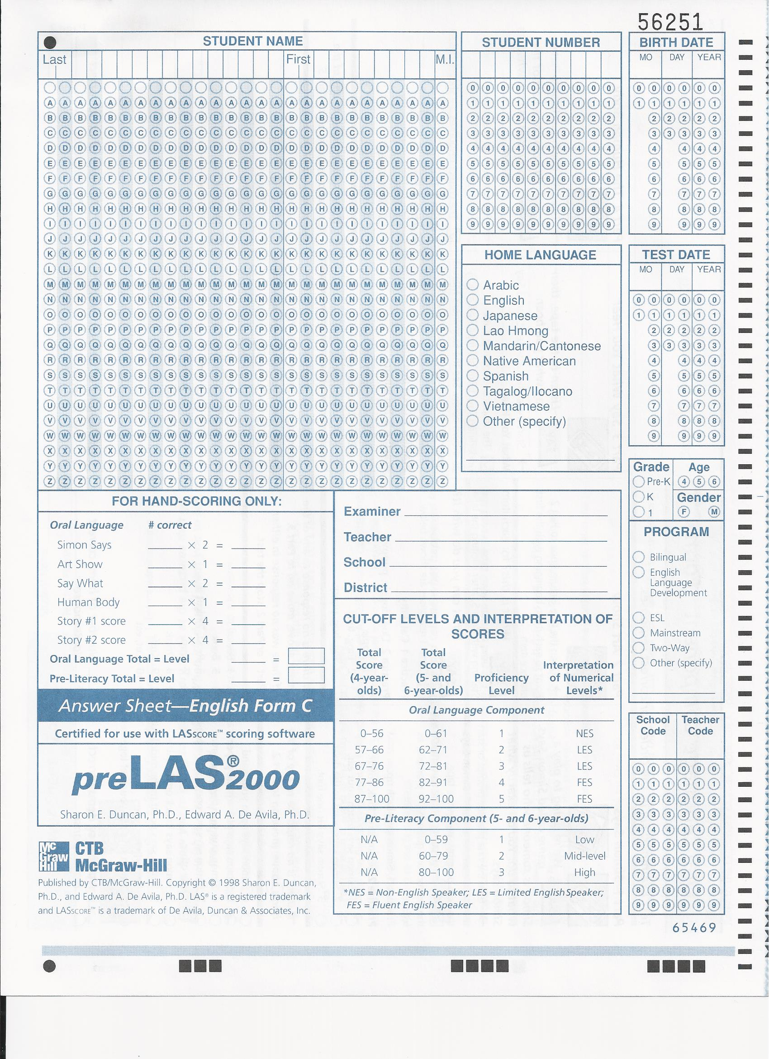
preLAS

Slide 10
preLAS

Slide 11
preLAS

Slide 12
Test Administration
preLAS
Student Testing

Slide 13
preLAS 2000 Components
preLAS
Descriptions found on page 2 in the Examiner’s Manual

Slide 14
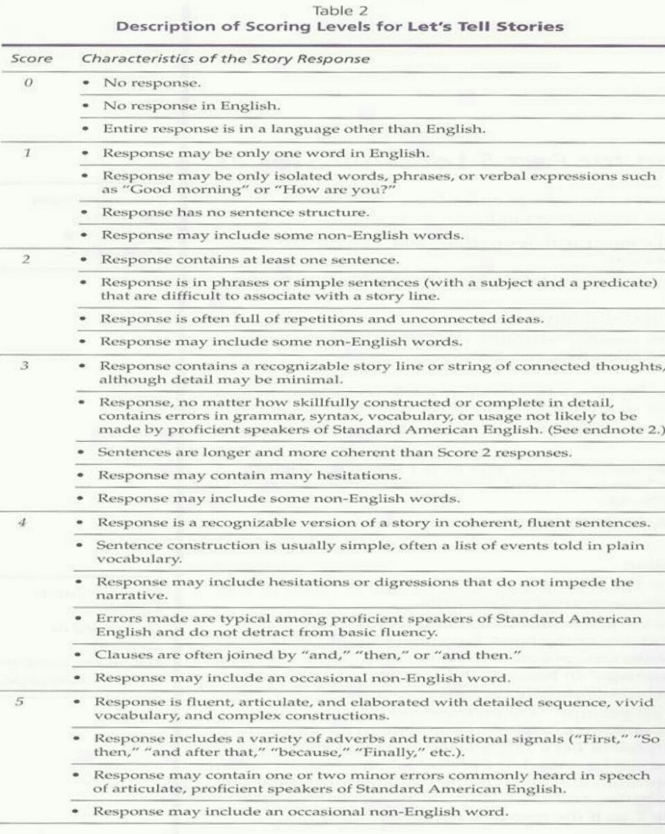
preLAS
0 = NR, I don’t know, Response in another language
1 = Isolated words, fragments, no sentence structure
2 = at least one sentence appears, phrases, fragments, no story line
3 = story line, with errors in syntax, grammar, etc…
4 = recognizable version of a story in coherent fluent sentences, simple word choice
5 = fluent, elaborate, detailed

Slide 15
Scoring preLAS
preLAS
Parts 1-4 are scored using a number correct recorded the bottom of each subtest
Part 5 is scored using the rubric found on page 26 of the Examiner’s Manual
Scores are tabulated on the front of the student answer sheet
Proficiency Level and Total Score reporting

Slide 16
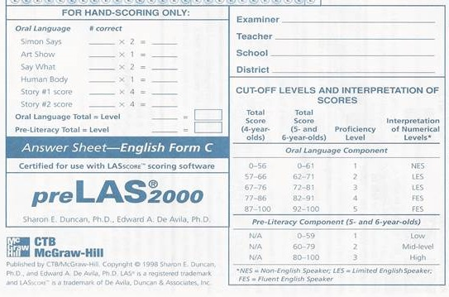
preLAS Scoring
preLAS

Slide 17
Pre-Literacy Component
preLAS
Pre–literacy skills are assessed with a fun board game that is designed to capture receptive and expressive language skills in action.
As the teacher helps the student move around the board, these skills are assessed:
Upper and lowercase letter recognition
Number recognition and concepts
Color recognition
Shapes and spatial relationships
Reading two– and three–letter sight words
Writing name, age, and two– and three–letter sight words.

Slide 18
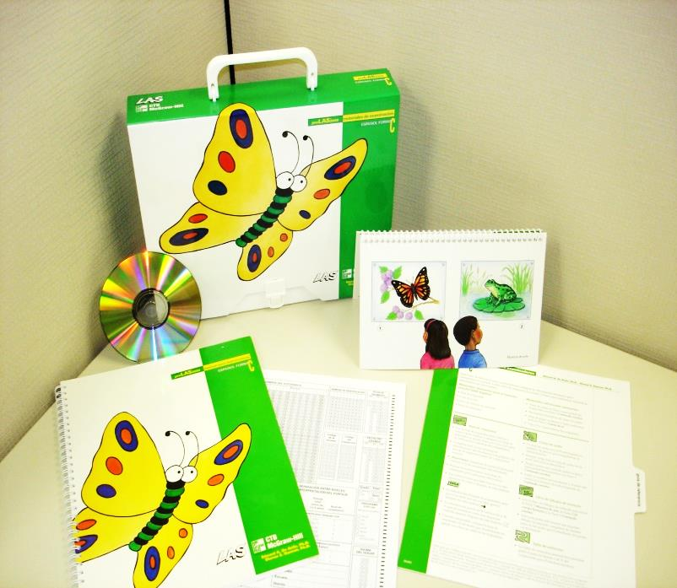
Thank you!
preLAS
Questions?
Contact me:
Gina Davis
gdavis@datarecognitioncorp.com
210.861.7445

